Slide 1


Department of Computer Science Engineering
191CS77A – Project Work(Phase 2) – Third Review
Dynamic Hash-Driven Malware Detection with Automatic Signature Updates
Team Members:
Saravanan.P-113121UG03092
Sudharsan.R-113121UG03105
Tharunadhithya.A-113121UG03111
Guided By:
Mrs. Vinothini.A, B.E.,M.E.
ASSISTANT PROFESSOR
DEPT. OF CSE
Batch No.: 13
Date: 24/2/2025

Slide 2


OUTLINE OF PRESENTATION
Problem Statement
Objective
Abstract
Introduction
Existing System
Proposed System
Software and Hardware Requirements
Future Enhancements
References

Slide 3

Problem statement
The increasing prevalence of cyber threats and malware attacks requires efficient and up-to-date malware detection systems. Existing systems primarily rely on traditional methods like signature-based detection, which can be slow to detect newly emerging threats. This leads to the problem of missed detections and delayed responses.
Moreover, mainstream anti-virus software tends to be resource-intensive, which can degrade performance on resource-constrained devices.
The problem lies in the need for a lightweight, efficient, and constantly updated malware detection system that can quickly identify both known and emerging threats without consuming excessive system resources.

Slide 4




OBJECTIVE
The primary objective of this project is to design and develop a malware detection tool that efficiently identifies malware using a hash-based scanning method. This tool will feature automated signature updates, ensuring that it is always equipped with the latest definitions of known malware.
The system will be lightweight and capable of scanning large directories quickly by leveraging multi-threaded scanning techniques. Additionally, the tool will be highly customizable, allowing users to specify the file types and directories to be scanned, thus ensuring flexibility for different use cases.
As the project evolves, there will be room for future upgrades, including the integration of machine learning for anomaly detection, cloud-based threat intelligence sharing, and behavioral analysis for more advanced malware detection.

Slide 5

ABSTRACT
With the continuous evolution of cyber threats, traditional malware detection techniques that rely solely on signature-based methods are becoming less effective at identifying emerging threats.
Our project proposes a hash-based malware detection system that offers a faster, more efficient, and constantly updated approach to malware detection. Our tool will automatically update its signature database from external sources, ensuring it stays current with new malware definitions.
The use of multi-threaded scanning will speed up the process, while the system's lightweight design ensures minimal impact on system resources.

Slide 6


INTRODUCTION
As cyber-attacks grow increasingly sophisticated, traditional antivirus systems often struggle to keep pace with new and evolving threats.
Moreover, many mainstream antivirus solutions are resource-heavy, requiring significant CPU and memory usage for real-time scanning, which can be problematic for users with lower-end hardware or embedded systems.
As a result, there is a need for a lightweight, efficient, and constantly updated malware scanner that can detect both known and emerging threats while minimizing its impact on system performance.
Our project aims to develop a hash-based malware detection tool that not only ensures the timely update of malware signatures but also provides efficient, parallel scanning to accommodate a variety of use cases.

Slide 7


EXISTING SYSTEM
Traditional malware detection systems rely primarily on signature-based detection to identify known threats.
These systems compare the hash of a file against a database of known malware signatures. While effective for known malware, this method is unable to detect new, modified, or polymorphic threats.
Popular mainstream solutions such as McAfee, Norton, and Windows Defender integrate various techniques but often suffer from performance overhead and frequent updates that require user intervention.
Hence,the need for a more lightweight and automated solution is evident.

Slide 8







PROPOSED SYSTEM
Automatic Signature Updates: The malware signature database will be automatically updated from trusted external sources (e.g., Abuse.ch or other repositories).This ensures the tool stays up-to-date with the latest known malware signatures without user intervention.
Multi-Threaded Scanning: The scanning process will leverage multi-threading to scan multiple files simultaneously, speeding up the detection process significantly, especially for large directories.
Lightweight Design: The system will be lightweight and will consume minimal resources during operation, making it suitable for use on older systems or embedded devices with limited hardware.
Minimal User Interaction: The tool will require minimal user interaction, with most updates and scans happening automatically, providing a seamless user experience.
No Resource Overhead: Designed to minimize the impact on system resources, the tool will not slow down system performance or consume excessive memory or CPU during scanning.

Slide 9
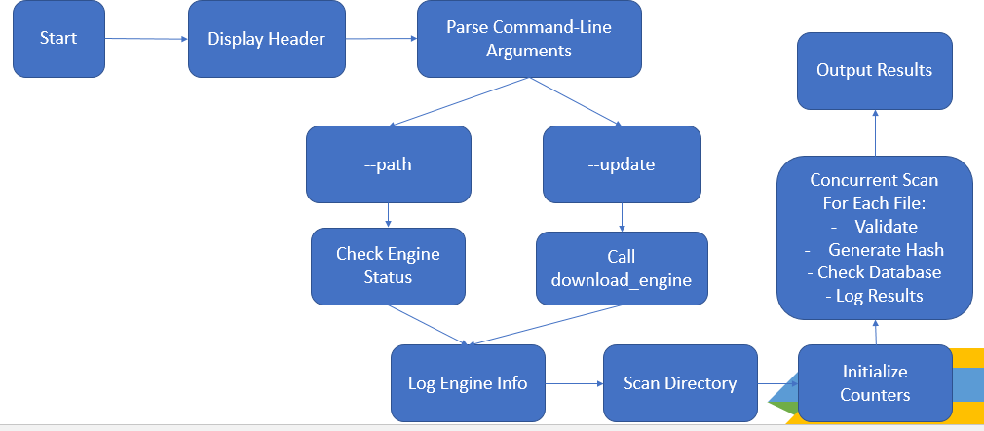
ARCHITECTURE DIAGRAM

Slide 10
Software and Hardware Requirements
SOFTWARE REQUIREMENTS:
1.Operating System: Windows, Linux, or macOS (multi-platform support).
2. Simulation Tool: Anaconda (Jupyter Notebook)
3. Programming Language: Python(3.x) due to its rich set of libraries, and cross-platform compatibility.
4. External APIs/Databses: Abuse.ch Database or similar for malware hashes.
HARDWARE REQUIREMENTS:
1.Processor: Multi-core CPU (Intel Core i5 or equivalent)
2. RAM: Preferably 4 GB or more
3. Storage: 80 GB hard disk capacity

Slide 11
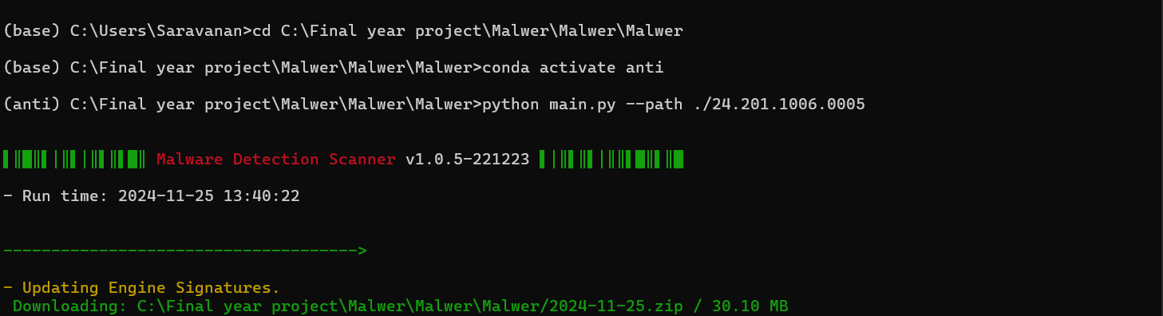
Engine Download

Slide 12
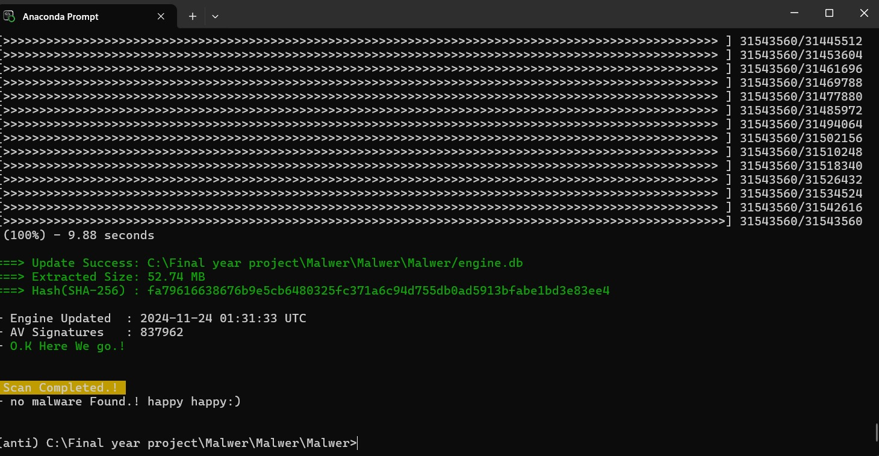
SCANNING PROCESS

Slide 13
OUTPUT FILE

Slide 14
FUTURE ENHANCEMENTS
Future enhancements for our malware detection system include integrating machine learning for anomaly detection, enabling the identification of unknown threats based on behavior patterns. Cloud-based threat intelligence integration would provide real-time updates, while heuristic-based detection could improve the identification of polymorphic malware by analyzing suspicious behaviors.
The system could be optimized for low-resource platforms and include customizable alerting and reporting features for better user engagement.
Advanced machine learning techniques, including deep learning, would improve detection accuracy, while automated incident response would allow for quick, predefined actions to mitigate threats, reducing the need for manual intervention.
These upgrades would make the system more intelligent, scalable, and proactive against evolving cyber threats.

Slide 15




References
Aathika Salam, M.S Hassim, Praneeth Nandana Jayawickrama, Anuruddha Bandara Muhandiram, "AntiXcavator: Automated Host-Based Detection and Prevention Tool for Crypto-Mining Malware Using Static and Dynamic Analysis," 5th International Conference on Advancements in Computing (ICAC), IEEE,2023
Anas AlMajali, Ahmad Qaffaf, Natali Alkayid, Yatin Wadhawan, “Crypto-Ransomware Detection Using Selective Hashing”, International Conference on Electrical and Computing Technologies and Applications (ICECTA),IEEE, 2022.
Yunchun Zhang; Zikun Liao; Ning Zhang; Shaohui Min; Qi Wang; Tony Q. S. Quek, "Deep Hashing for Malware Family Classification and New Malware Identification," IEEE Internet of Things Journal, 2024.

Slide 16

THANK YOU

